Slide 1
Confounding and Interaction: Part II
Methods to Reduce Confounding
during study design:
Randomization
Restriction
Matching
during study analysis:
Stratified analysis
Multivariable analysis
Interaction
What is it? How to detect it?
Additive vs. multiplicative interaction?
Statistical testing for interaction
Implementation in Stata

Slide 2
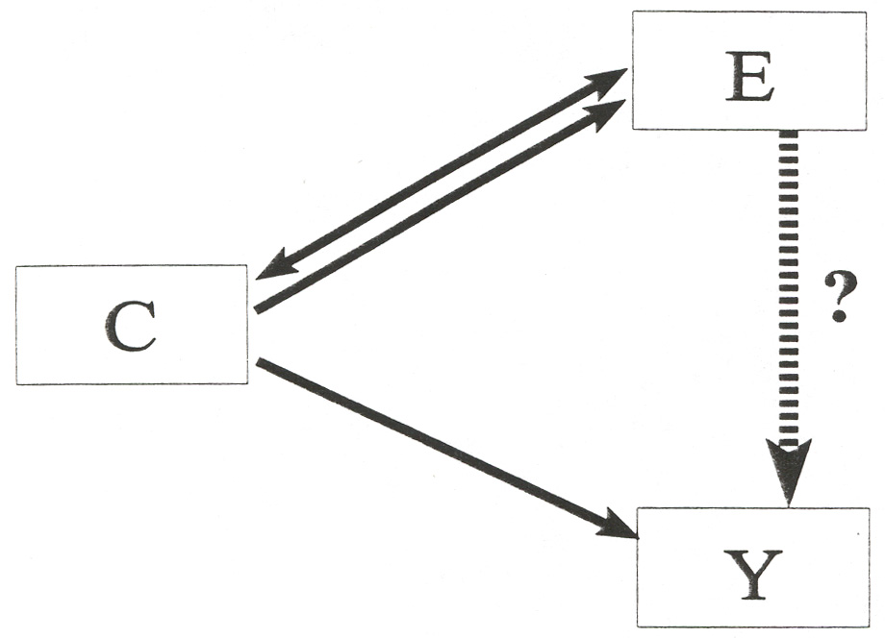
Methods to Prevent or Manage Confounding
D
or
D

Slide 3
Methods to Prevent or Manage Confounding
By prohibiting at least one “arm” of the exposure- confounder - disease structure, confounding is precluded

Slide 4
Randomization to Reduce Confounding
Definition: random assignment of subjects to exposure (treatment) categories
All subjects → Randomize
One of the most important inventions of the 20th Century!
Applicable only for intervention studies
By eliminating any association between exposure and the potential confounder, it precludes confounding
Special strength of randomization is its ability to control the effect of confounding variables about which the investigator is unaware
Does not, however, eliminate confounding!
Exposed
Unexposed

Slide 5
Restriction to Reduce Confounding
AKA Specification
Definition: Restrict enrollment to only those subjects who have a specific value of the confounding variable
e.g., when age is confounder: include only subjects of same narrow age range
Advantages:
conceptually straightforward
Disadvantages:
may limit number of eligible subjects
inefficient to screen subjects, then not enroll
“residual confounding” may persist if restriction categories not sufficiently narrow (e.g. “decade of age” might be too broad)
limits generalizability
not possible to evaluate the relationship of interest at different levels of the restricted variable (i.e. cannot assess interaction)

Slide 6
Matching to Reduce Confounding
Definition: Subjects with all levels of a potential confounder are eligible for inclusion BUT the unexposed/non-case subjects (either with respect to exposure in a cohort or disease in a case-control study) are chosen to have the same distribution of the potential confounder as seen in the exposed/cases
Mechanics depends upon study design:
e.g. cohort study: unexposed subjects are “matched” to exposed subjects according to their values for the potential confounder.
e.g. matching on race
One unexposed_{black} enrolled for each exposed_{black}
One unexposed_{asian} enrolled for each exposed_{asian}
e.g. case-control study: non-diseased controls are “matched” to diseased cases
e.g. matching on age
One control_{age} ₅₀ enrolled for each case_{age} ₅₀
One control_{age} ₇₀ enrolled for each case_{age} ₇₀

Slide 7
Methods to Prevent or Manage Confounding
D
or
D

Slide 8
Advantages of Matching
1. Useful in preventing confounding by factors which would be difficult to manage in any other way
e.g. “neighborhood” is a nominal variable with multiple values.
Relying upon random sampling of controls without attention to neighborhood may result in (especially in a small study) choosing no controls from some of the neighborhoods seen in the case group
Even if all neighborhoods seen in the case group were represented in the controls, adjusting for neighborhood with “analysis phase” strategies are problematic
2. By ensuring a balanced number of cases and controls (e.g. in a case-control study) within the various strata of the confounding variable, statistical precision is increased

Slide 9
Disadvantages of Matching
1. Finding appropriate matches may be difficult and expensive and limit sample size (e.g., have to throw out a case if cannot find a control). Therefore, the gains in statistical efficiency can be offset by losses in overall efficiency.
2. In a case-control study, factor used to match subjects cannot be itself evaluated as a risk factor for the disease. In general, matching decreases robustness of study to address secondary questions.
3. Decisions are irrevocable - if you happened to match on an intermediary, you likely have lost ability to evaluate role of exposure in question.
4. If potential confounding factor really isn’t a confounder, statistical precision will be worse than no matching.

Slide 10
Stratification to Reduce Confounding
Goal: evaluate the relationship between the exposure and outcome in strata homogeneous with respect to potentially confounding variables
Each stratum is a mini-example of restriction!
CF = confounding factor
Crude
Stratified
CF Level I
CF Level 2
CF Level 3

Slide 11
Smoking, Matches, and Lung Cancer
Crude
OR _{crude}
Stratified
Smokers
Non-Smokers
OR _{CF+} = OR_{smokers}
OR _{CF-} = OR_{non-smokers}
OR_{crude} = 8.8 (7.2, 10.9)
OR_{smokers} = 1.0 (0.6, 1.5)
OR_{non-smoker} = 1.0 (0.5, 2.0)

Slide 12
Stratifying by Multiple Confounders
Crude
Potential Confounders: Race and Smoking
To control for multiple confounders simultaneously, must construct mutually exclusive and exhaustive strata:

Slide 13
Stratifying by Multiple Confounders
Crude
Stratified
white smokers
black smokers
latino smokers
white non-smokers
black non-smokers
latino non-smokers

Slide 14
Summary Estimate from the Stratified Analyses
Goal: Create an unconfounded (“adjusted”) estimate for the relationship in question
e.g. relationship between matches and lung cancer after adjustment (controlling) for smoking
Process: Summarize the unconfounded estimates from the two (or more) strata to form a single overall unconfounded “summary estimate”
e.g. summarize the odds ratios from the smoking stratum and non-smoking stratum into one odds ratio

Slide 15
Smoking, Matches, and Lung Cancer
Crude
OR _{crude}
Stratified
Smokers
Non-Smokers
OR _{CF+} = OR_{smokers}
OR _{CF-} = OR_{non-smokers}
OR_{crude} = 8.8 (7.2, 10.9)
OR_{smokers} = 1.0 (0.6, 1.5)
OR_{non-smoker} = 1.0 (0.5, 2.0)

Slide 16
Smoking, Caffeine Use and Delayed Conception
Crude
RR _{crude} = 1.7
Stratified
Heavy Caffeine Use
No Caffeine Use
RR_{caffeine use} = 0.7
RR_{no} _{caffeine use} = 2.4

Slide 17
Underlying Assumption When Forming a Summary of the Unconfounded Stratum-Specific Estimates
If the relationship between the exposure and the outcome varies meaningfully (in a clinical/biologic sense) across strata of a third variable, then it is not appropriate to create a single summary estimate of all of the strata
i.e. the assumption is that no interaction is present

Slide 18
Interaction
Definition
when the magnitude of a measure of association (between exposure and disease) meaningfully differs according to the value of some third variable
Synonyms
Effect modification
Effect-measure modification
Heterogeneity of effect
Proper terminology
e.g. Smoking, caffeine use, and delayed conception
Caffeine use modifies the effect of smoking on the occurrence of delayed conception.
There is interaction between caffeine use and smoking in the occurrence of delayed conception.
Caffeine is an effect modifier in the relationship between smoking and delayed conception.

Slide 21
Interaction is likely everywhere
Susceptibility to infections
e.g.,
exposure: sexual activity
disease: HIV infection
effect modifier: chemokine receptor phenotype
Susceptibility to non-infectious diseases
e.g.,
exposure: smoking
disease: lung cancer
effect modifier: genetic susceptibility to smoke
Susceptibility to drugs
effect modifier: genetic susceptibility to drug
But in practice is difficult to find and document

Slide 22
Smoking, Caffeine Use and Delayed Conception: Additive vs Multiplicative Interaction
Crude
RR _{crude} = 1.7
RD _{crude} = 0.07
Stratified
Heavy Caffeine Use
No Caffeine Use
RR_{caffeine use} = 0.7
RD_{caffeine use} = -0.06
RR_{no} _{caffeine use} = 2.4
RD_{no} _{caffeine use} = 0.12
RD =
Risk Difference = Risk _{exposed} - Risk _{Unexposed}
aka Attributable Risk

Slide 23
Additive vs Multiplicative Interaction
Assessment of whether interaction is present depends upon which measure of association is being evaluated
ratio measure (multiplicative interaction) or difference measure (additive interaction)
Absence of multiplicative interaction always implies presence of additive interaction
Absence of additive interaction always implies presence of multiplicative interaction
Presence of multiplicative interaction may or may not be accompanied by additive interaction
Presence of additive interaction may or may not be accompanied by multiplicative interaction
Presence of qualitative multiplicative interaction is always accompanied by qualitative additive interaction
Hence, the term effect-measure modification

Slide 24
Additive vs Multiplicative Scales
Additive measures (e.g., risk difference, aka attributable risk):
readily translated into impact of an exposure (or intervention) in terms of number of outcomes prevented
e.g. 1/risk difference = no. needed to treat to prevent (or avert) one case of disease
gives “public health impact” of the exposure
Multiplicative measures (e.g., risk ratio)
favored measure when looking for causal association

Slide 25
Additive vs Multiplicative Scales
Causally related but minor public health importance
RR = 2
RD = 0.0001 - 0.00005 = 0.00005
Need to eliminate exposure in 20,000 persons to avert one case of disease
Causally related but major public health importance
RR = 2
RD = 0.2 - 0.1 = 0.1
Need to eliminate exposure in 10 persons to avert one case of disease

Slide 26
Smoking, Family History and Cancer: Additive vs Multiplicative Interaction
Crude
Stratified
Family History Present
Family History Absent
RR_{family history} = 2.0
RD_{family history} = 0.20
RR_{no} _{family history} = 2.0
RD_{no} _{family history} = 0.05
No multiplicative interaction but presence of additive interaction
If goal is to define sub-groups of persons to target:
- Rather than ignoring, it is worth reporting that only 5 persons with a family history have to be prevented from smoking to avert one case of cancer

Slide 27
Confounding vs Interaction
Confounding
An extraneous or nuisance pathway that an investigator hopes to prevent or rule out
Interaction
A more detailed description of the “true” relationship between the exposure and disease
A richer description of the biologic system
A finding to be reported, not a bias to be eliminated

Slide 28
Smoking, Caffeine Use and Delayed Conception
Crude
RR _{crude} = 1.7
Stratified
Heavy Caffeine Use
No Caffeine Use
RR_{caffeine use} = 2.4
RR_{no} _{caffeine use} = 0.7
RR _{adjusted} = 1.4 (95% CI= 0.9 to 2.1)
Here, adjustment is contraindicated!

Slide 29
Chance as a Cause of Interaction?
Crude
OR _{crude} = 3.5
Stratified
Age < 35
Age > 35
OR_{age <35} = 3.4
OR_{age >35} = 5.7

Slide 30
Statistical Tests of Interaction: Test of Homogeneity
Null hypothesis: The individual stratum-specific estimates of the measure of association differ only by random variation
i.e., the strength of association is homogeneous across all strata
i.e., there is no interaction
A variety of formal tests are available with the general format, following a chi-square distribution:
where:
effect_{i} = stratum-specific measure of assoc.
var(effect_{i}) = variance of stratum-specifc m.o.a.
summary effect = summary adjusted effect
N = no. of strata of third variable
For ratio measures of effect, e.g., OR, log transformations are used:
The test statistic will have a chi-square distribution with degrees of freedom of one less than the number of strata

Slide 31
Interpreting Tests of Homogeneity
If the test of homogeneity is “significant”, this is evidence that there is heterogeneity (i.e. no homogeneity)
i.e., interaction may be present
The choice of a significance level (e.g. p < 0.05) is somewhat controversial.
There are inherent limitations in the power of the test of homogeneity
p < 0.05 is likely too conservative
One approach is to declare interaction for p < 0.20
i.e., err on the side of assuming that interaction is present (and reporting the stratified estimates of effect) rather than on reporting a uniform estimate that may not be true across strata.

Slide 32
Tests of Homogeneity with Stata
1. Open Stata
2. Load dataset
From File menu, choose Open
Go to directory where dataset resides and select the file
Click Open (the variables in the dataset should appear in the “Variables” window)
3. Determine crude measure of association
e.g. for a cohort study
“cs outcome-variable exposure-variable”
for smoking, caffeine, delayed conception: -exposure variable = smoking
-outcome variable = delayed
-third variable = caffeine
“cs delayed smoking”
4. Determine stratum-specific estimates by levels of third variable
“cs outcome-v. exposure-v., by(third-variable)”
e.g. cs delayed smoking, by(caffeine)

Slide 33
. cs delayed smoking
| smoking |
| Exposed Unexposed | Total
-----------------+------------------------+----------
Cases | 26 64 | 90
Noncases | 133 601 | 734
-----------------+------------------------+----------
Total | 159 665 | 824
| |
Risk | .163522 .0962406 | .1092233
| Point estimate | [95% Conf. Interval]
|------------------------+----------------------
Risk difference | .0672814 | .0055795 .1289833
Risk ratio | 1.699096 | 1.114485 2.590369
+-----------------------------------------------
chi2(1) = 5.97 Pr>chi2 = 0.0145
. cs delayed smoking, by(caffeine)
caffeine | RR [95% Conf. Interval] M-H Weight
-----------------+-------------------------------------------------
no caffeine | 2.414614 1.42165 4.10112 5.486943
heavy caffeine | .70163 .3493615 1.409099 8.156069
-----------------+-------------------------------------------------
Crude | 1.699096 1.114485 2.590369
M-H combined | 1.390557 .9246598 2.091201
-----------------+-------------------------------------------------
Test of homogeneity (M-H) chi2(1) = 7.866 Pr>chi2 = 0.0050

Slide 34
Declare vs Ignore Interaction?

